Slide 1
Linux Basic commands

Slide 2
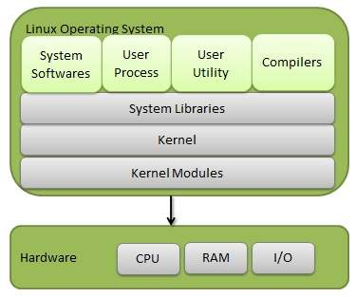
Linux is an operating system based on UNIX
first introduced by Linus Torvalds
Components of linux

Slide 3
ls
List commands to show the content of directory
ls –l
To get detailed Information/list of the directory content
ls –a
To list f all files/dir including hidden object.
Cd
Change directory

Slide 4
pwd
Print Working directory
mkdir directory_name
To create a new directory.
Cat
Is used to list the content of file on console
cat > filename
It is used to create a file with content. And can concatenate two or more file contents.
cp
Copy the file/dir
mv
Move the file/dir or rename it

Slide 5
Touch
Is used to create empty file
Vi and Vim
Text editor in linux
Echo
Is used to print on console
Whoami print the username
Hostnamectl
To check current hostname

Slide 6
Chmod
Is used to change permission of file like read,write,execute
Chgrp
To change the group ownership of file/dir
Tar
Is used to create archiving file/dir into a single file
tar –cvf tarname.tar filename
To create a tar file
tar –tvf filename.tar
To check the contents of tar file
tar –xvf filename.tar
To extract the file contents of tar or compressed file
Ps
To show all running processes

Slide 7
Demidecode
To know the system hardware related information
Lsblk
To display information about block devices
Uname
To display os name ,-a :- the system node name, operating system release, operating system version, hardware name, and processor type.
Lsb_release
To display information about linux distribution including distribution id,version etc
Chown
To change the ownership of file/dir
Grep
For pattern searching
Find :- find . –name file/dirname
Searching file

Slide 8
Groupadd
To create new group :- to add user to group usermod –G groupname,amd username
Useradd
To create new user
To create passwd :- passwd username
Tail
Display bottom 10 line of file
Head
Display top 10 line of file
Sudo
To give root level privileges

Slide 9
Wget
To download from the internet
Systemctl
To examine and control state of system and service manager
Gzip
To compress files
Gunzip
To uncompress zip files
Sudo apt install softwarename
Install,ugrade,or remove software packages

Slide 10
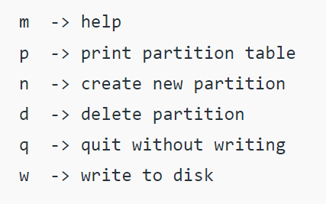
Disk partition
Lsblk
To know available disk partition on system
Sudo fdisk /dev/sda
rm /rmdir
To remove file /dir

